Slide 1
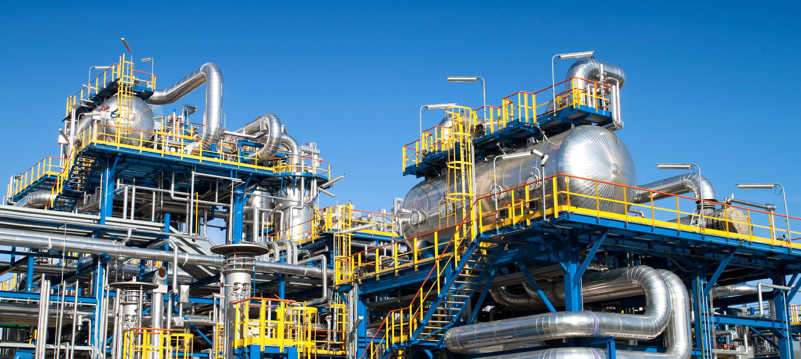
Portrait of the German Chemical Industry
Data and facts at a glance
© cobalt/stock.adobe.com
Status: July 2022 (automatic translation of the German version)

Slide 2
Table of contents
Industry portrait - Key figures at a glance 2021
Importance of the sector and engine of the industry: shares in manufacturing
Raw material base of the chemical industry
Value chains, sales structure and new value creation structures
Innovation driver of a circular future, digitalisation as an "enabler" of a circular economy
Global player and SME
Employment and training
Energy-intensive sector
Research-intensive industry
Strong domestic investment
Export-oriented industry
Foreign investments, market development strategies and subsidiaries abroad
Further information

Slide 3
Sector portrait - Key figures at a glance 2021
Wide product range
Turnover: 227 billion euros, of which 60 % abroad
  3rd place after automotive and mechanical engineering
Rank 1 in Europe, rank 3 worldwide
Production growth in the last 5 years: 0.9 %.
473,200 employees, highest figure in 20 years
Capital expenditure on property, plant and equipment in Germany: 8.6 billion euros, abroad: 9.4 billion euros
R&D expenditure: 13.2 billion euros
SME share: > 90 %
Sources: Federal Statistical Office, VCI

Slide 4
Importance of the industry for the overall economy
Indirect effects
Direct effects
Induced effects
Demand from chemical and pharmaceutical companies for materials, services, etc. in other sectors creates employment and value creation there.
Employees and value added in the sector:
464,400 employees
58 billion value added
Spending and consumption by people employed in the sector creates employment and value added in other sectors.
Overall economic effect
Every job in the companies in the sector leads to about 2 more jobs in the German economy. At last count, this amounted to around 900,000 people.
Every euro of direct value added generated by companies in the sector triggers another 0.8 euros of additional value added in the German economy. Most recently, this was around 48 billion euros.
Sources: IW Cologne, VCI

Slide 5
The sector is the core of Germany as an industrial country
It is capital-, research- and energy-intensive and export-oriented
Key figures at a glance
Shares of the industry in manufacturing, 2021
The German chemical and pharmaceutical industry generates more than 11 percent of the turnover in the manufacturing sector.
Research and development (R&D) and investments have a high priority in the industry.
Chemistry is energy-intensive.
The industry is active worldwide and competes internationally.
Sources: Destatis, Stifterverband, VCI

Slide 6
The sector comes third among industrial sectors in Germany
Share of manufacturing turnover
In percent, 2021
The German chemical and pharmaceutical industry generates more than 11 percent of the turnover in the manufacturing sector.
This is third after vehicle manufacturing and mechanical engineering.
Sources: Destatis, VCI

Slide 7
The raw material base of the chemical industry
Naphtha is the most important raw material in organic chemistry
Raw material base of organic chemistry in Germany, in million tonnes, shares in percent, 2020
Mineral oil products are still the most important raw materials for production in the chemical industry.
So far, renewable raw materials have a share of a good 13 percent. They mainly go directly into the production of special chemicals.
Sources: VCI, FNR
Basis: tonnes of raw material

Slide 8
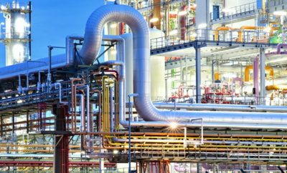
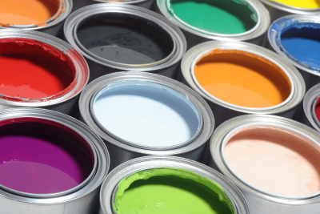


Chemistry is at the beginning of many value chains
processing industry
Manufacturers of consumer and capital goods
Basic chemistry
Specialty Chemicals
JT Jeeraphun/stock.adobe.com
rockpix/stock.adobe.com
irina/stock.adobe.com
scharfsinn86/stock.adobe.com

Slide 9
Domestic production is further processed within the industry
Domestic sales structure of the chemical-pharmaceutical industry
2019
Domestically, almost one third of domestic production goes directly to consumption and 4 percent to service sectors.
More than 60 per cent of the production is further processed within the industry (without pharmaceuticals, the share rises to 84 per cent).
Due to the high value-added depth of the industry, further processing also mainly happens within the chemical and pharmaceutical industry. The chemical industry itself is its best supplier and customer.
Source: Destatis, VCI

Slide 10
Main domestic customers for chemical products: plastics processors
Sales of the chemical and pharmaceutical industry to other industrial sectors
2019, excluding deliveries to the chemical industry, DL, consumption and abroad
The main customers of the industry are plastics processors. Vehicle construction follows in 5th place.
However, only direct sales are taken into account here. If indirect deliveries (via plastics processors, the electrical industry, the textile industry, mechanical engineering) are included, around 15-20 percent of domestic production goes to the automotive industry.
Source: Destatis, VCI

Slide 11
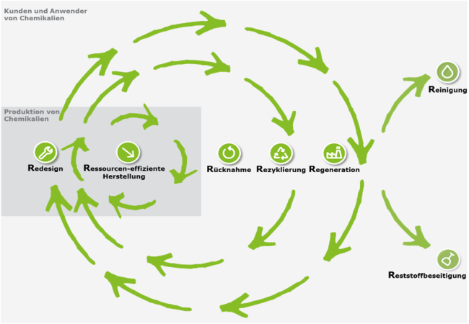
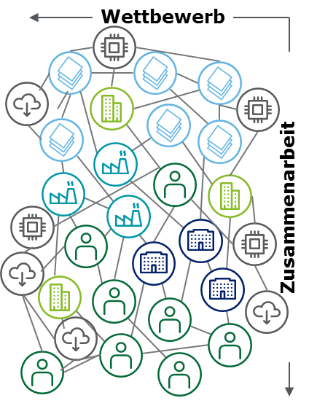
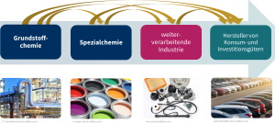
New value creation structures emerge
Global value chains
Circular economy
Digitalisation and networking
Chemistry:
Growth and innovation engine
At the beginning of global value chains
Threat of slow growth, erosion of innovation leads and locational disadvantages
Chemistry:
Enablers of the circular economy
Efficient and climate-friendly production
Essential part of global value chains
Chemistry:
Exploits the opportunities of digitalisation
Develops new business models
New distribution of roles in global value creation networks

Slide 12
Chemistry: Innovation engine of a circular future
Circular economy
Resource base | Resource efficiency | Resource conservation | Circular economy
Renewable
Energy
Renewable raw materials
Secondary raw materials
Throughout the product life cycle:
Supplier
Production
Customer
Climate protection
Conservation of ecosystems
Take-back
Reuse
Material and energy recovery

Slide 13


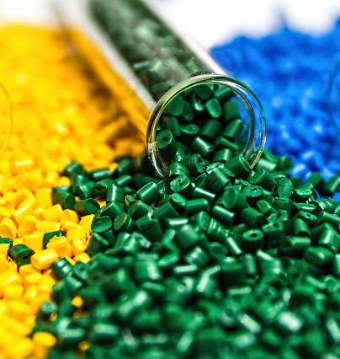
Digitalisation drives circular economy
Sashkin/stock.adobe.com
Roman Milert/stock.adobe.com
mrmrsmarcha1/stock.adobe.com
Blockchain solutions to enable the traceability of substances in the value chain
Digital currencies to incentivise the collection of plastics in developing countries
Digital platforms for the trade of high-purity recyclables

Slide 14
Many global players in the chemical and pharmaceutical industry
The 20 top-selling German chemical companies in 2021
Many globally active chemical and pharmaceutical companies have their headquarters in Germany.
Large chemical companies often supply intermediate products that medium-sized companies process into end products. This distinguishes the chemical industry from other sectors.
Source: Die Welt (19 July 2021)

Slide 15
Over 90 percent of the companies are medium-sized
Size structure of the chemical-pharmaceutical industry
Number of companies, employees and turnover by size class, 2020, shares in percent
With a good 2,000 companies, over 92 percent of the chemical companies are small and medium-sized enterprises (SMEs) with fewer than 500 employees.
With almost 179,000 employees, 36 percent of the chemical workforce work in SMEs.
SMEs generate more than 28 percent of chemical sales. That was 63 billion euros at last count.
The production of basic chemicals is the domain of large companies. SMEs then process these products into fine and speciality chemicals.
Sources: Destatis, VCI

Slide 16
Rising employment figures over the past 10 years
Employees in the chemical and pharmaceutical industry
in 1000
The German chemical industry is the sixth largest employer in Germany.
The sector offers secure and well-paid jobs and has built up employment in recent years (+58,000 employees since 2010).
With an average of almost 64,000 euros in 2021, salaries in the sector are almost
almost 25 percent above the average for the manufacturing sector.
Source: Destatis

Slide 17
The industry trains
Apprenticeships in Germany
Number of apprenticeships in the chemical and pharmaceutical industry + parts of the rubber and plastics industry (BAVC)
For the technically demanding jobs, the chemical industry needs qualified and competent employees. That is why it trains its own employees.
Due to the pandemic, less capacity is available for training in technical centres, laboratories and workshops. In addition, the training market is changing. More and more positions cannot be filled. This has recently depressed the supply of training places.
After successful completion of training, more than 90 per cent of those trained are taken on (2021: 93 per cent).
BAVC delimitation including parts of the rubber and plastics industry
Source: BAVC

Slide 18
Chemistry is energy-intensive, but reduces energy consumption and emissions
Shares of the chemical and pharmaceutical industries in manufacturing consumption
Final energy consumption by energy source and total, 2020
Almost 9 percent of Germany's energy consumption and almost 23 percent of the energy consumption of the manufacturing industry is accounted for by the chemical industry. If the material use of energy sources is added, the industry has a share of over 30 percent.
Since 1990, energy consumption in the sector has fallen by 19 percent.
Overall, the industry is responsible for 5.5 percent of CO2 emissions in Germany. Compared to 1990, the industry has reduced its energy consumption and greenhouse gas emissions by around 55 percent.
Source: Destatis, VCI
Without material use

Slide 19
The German chemical and pharmaceutical industry is strong in research
Research and development expenses
External and internal R&D expenditure of the chemical and pharmaceutical industry in billion euros
The Corona measures put the brakes on research and development. Budgets recovered to almost pre-crisis levels in 2021.
With 13.2 billion euros, the industry recently invested almost 6 percent of its turnover in R&D.
Only vehicle manufacturing and the electrical industry invest more in research and development.
Sources: Stifterverband, VCI
2021: Estimate
Notes:
The chemical-pharmaceutical industry has invested well over 10 billion euros in research and development in recent years.
R&D expenditure in the chemical-pharmaceutical industry is growing dynamically. Since 2008, expenditure has risen by an average of 3.6 percent per year. The growth is no longer driven solely by the pharmaceutical industry's expenditure. R&D expenditure in the chemical industry has also increased.
In 2017, 55.5 percent of internal R&D expenditure in the chemical industry went to experimental development, 38 percent to applied research and around 6.5 percent to basic research. In the pharmaceutical industry, almost 56 percent went to applied research, 31 percent to experimental development and around 13 percent to basic research.
Note: All R&D expenditure (internal and external) performed by industry is covered (GERD delineation).

Slide 20
The industry is capital intensive and invests in transformation
Capital expenditure on property, plant and equipment by the German chemical/pharmaceutical industry
in million euros and trend
bre
Turnaround in investment: Domestic investment has been rising strongly since 2010.
The transformation requires investment: According to the "Roadmap Chemistry 2050", additional investments of more than 60 billion euros are needed by 2050.
Sources: Destatis, VCI
2021: Estimate

Slide 21
The industry is export-oriented - its most important sales market is Europe
Exports of the German chemical and pharmaceutical industry by region
Shares in percent, 2021
Europe is the most important sales market for the German chemical and pharmaceutical industry.
Half of the exports go to the EU 27 countries.
Another 16 per cent to the other countries in Europe.
USA is the most important market outside Europe.
Sources: Destatis, VCI
Estimate based on preliminary data

Slide 22
The industry invests abroad and benefits from market growth via production on site
Capital expenditure by the German chemical and pharmaceutical industry abroad
in million euros and trend
The dynamics of foreign investments in the German chemical and pharmaceutical industry are high. Since 2012, foreign investments have also exceeded domestic investments. Reasons for this:
  Globalisation strategy: Participation in market growth
  Cheaper raw material costs abroad
  Barriers to investment at home
Source: VCI
Notes:
Foreign investments are gaining in importance for chemical and pharmaceutical companies. Since 2012, foreign investments have exceeded investments in Germany. Not only market development, but increasingly also cost reasons play a role.

Slide 23
The German chemical and pharmaceutical industry is at home on the world markets
German chemical exports and sales of German chemical subsidiaries abroad
In billions of euros, 2020
Market development strategies differ depending on the region.
Europe is developed through exports - the turnover of the subsidiaries is far lower than the export earnings.
In Asia and North America, the sales of the subsidiaries there far exceed the export revenues.
The most important market for the German chemical industry is the EU. 50 percent of exports go to the EU. As a production location, the EU follows North America in second place.
Sources: German Bundesbank, Destatis, VCI

Slide 24
Importance of foreign subsidiaries is high
Key figures of the chemical subsidiaries of German companies abroad
2020
Sources: Deutsche Bundesbank, Federal Statistical Office, VCI

Slide 25
Further information
Facts and figures on investments in the industry: Focus on investments
Facts and figures on research and development: Germany as a location for innovation
Facts and figures on energy and raw materials:
Energy statistics at a glance
Facts and figures on global chemical markets: Chemical markets worldwide
Facts and figures on the industrial location: Industrial country Germany

Slide 26
VCI contact
Christiane Kellermann
Senior referee
Economics
T I +49 (69) 2556-1585
E I kellermann@vci.de

